Slide 1
Entities and relationships
INF08104: Database Systems
Brian Davison, 2014/15

Slide 2
Agenda
Relational operations
Foreign keys
Representing relationships
Referential integrity
JOIN operations in SQL
Advanced ER modelling
Problems

Slide 3
Operations on relations
SELECT
PROJECT
JOIN
PRODUCT
UNION
INTERSECT
DIFFERENCE
DIVIDE
Columns in one table matching all columns in another table

Slide 4
Operations on relations
SELECT
PROJECT
JOIN
PRODUCT
SELECT column names
FROM table name
WHERE criteria
PROJECT
SELECT

Slide 5
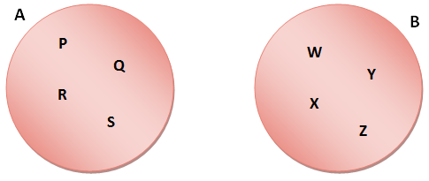
Operations on relations
JOIN
PRODUCT
All possible combinations
A X B = { P, Q, R, S} X {W, X, Y, Z} =
{ (P,W), (P,X), (P,Y), (P,Z), (Q,W), (Q,X), (Q,Y), (Q,Z),
(R,W), (R,X), (R,Y), (R,Z), (S,W), (S,X), (S,Y), (S,Z) }

Slide 6
The PRODUCT operation
dept_code | dept_name
COMP | Computing
BUS | Business
HEALTH | Health
dept_code | emp_code | surname
COMP | 100 | Smith
COMP | 101 | Jones
HEALTH | 102 | Brown
dept_code | dept_name | dept_code | emp_code | surname
COMP | Computing | COMP | 100 | Smith
COMP | Computing | COMP | 101 | Jones
COMP | Computing | HEALTH | 102 | Brown
BUS | Business | COMP | 100 | Smith
BUS | Business | COMP | 101 | Jones
BUS | Business | HEALTH | 102 | Brown
HEALTH | Health | COMP | 100 | Smith

Slide 7
The JOIN operation
Returns a combination of columns from more than one table where some condition is true
eg. Column x in one table = column y in another table
dept_code | dept_name
COMP | Computing
BUS | Business
HEALTH | Health
dept_code | emp_code | surname
COMP | 100 | Smith
COMP | 101 | Jones
HEALTH | 102 | Brown
dept_code | dept_name | emp_code | surname
COMP | Computing | 100 | Smith
COMP | Computing | 101 | Jones
HEALTH | Health | 102 | Brown

Slide 8
Foreign key
Identifies a unique related row in another table
PK
FK
PK
dept_code | dept_name
COMP | Computing
BUS | Business
HEALTH | Health
dept_code | emp_code | surname
COMP | 100 | Smith
COMP | 101 | Jones
HEALTH | 102 | Brown
dept_code | dept_name | emp_code | surname
COMP | Computing | 100 | Smith
COMP | Computing | 101 | Jones
HEALTH | Health | 102 | Brown

Slide 9

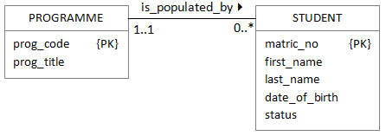
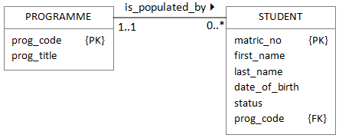
1:* relationships
A foreign key always corresponds to a primary key in another table
The foreign key is always at the "many" end of a relationship

Slide 10
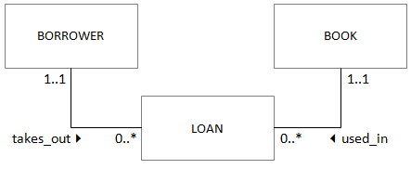

*:* relationships
The link table is at the "many" end of both relationships
The link table may consist only of foreign keys

Slide 11
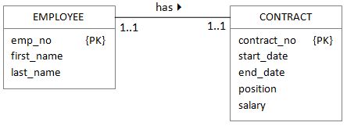
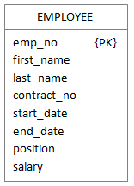
1:1 relationships: mandatory at both ends
Don't combine if
the two entity types represent different entities in the real world
the entities participate in very different relationships with other entities
a combined entity would slow down some database operations

Slide 12
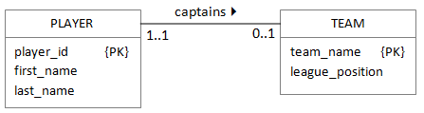
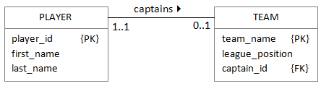
1:1 relationships: mandatory/optional

Slide 13
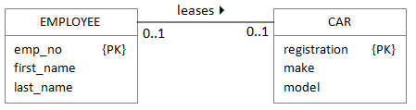
1:1 relationships: optional at both ends

Slide 14
Referential integrity
Must be possible to identify a parent record
If the foreign key field has a value, the corresponding parent record must exist
The DBMS prevents
Insertion of a child record with an unknown foreign key value
Deletion of a parent record while child records still exist
Ordering of operations is important when maintaining data

Slide 15
JOINS in SQL
SELECT <column names>
FROM <table1> JOIN <table2>
ON <join condition>
eg.
SELECT p.prog_name, s.matric, s.last_name, s.status
FROM student s JOIN programme p
ON s.prog_code = p.prog_code
WHERE p.prog_code = ‘BSc Comp'

Slide 16
Outer joins
Students
Test_scores
matric | surname | programme
08001234 | Smith | BSc IT
08002345 | Jones | BSc Comp
08003456 | Brown | BSc BIS
matric | score
08001234 | 65
08002345 | 52
SELECT *
FROM students s,
test_scores t
WHERE s.matric = t.matric
List all students and their test scores
matric | surname | programme | matric | score
08001234 | Smith | BSc IT | 08001234 | 65
08002345 | Jones | BSc Comp | 08002345 | 52
matric | surname | programme | matric | score
08001234 | Smith | BSc IT | 08001234 | 65
08002345 | Jones | BSc Comp | 08002345 | 52
08003456 | Brown | BSc BIS

Slide 17
LEFT or RIGHT?
Students
Test_scores
Matric | Surname | Programme
08001234 | Smith | BSc IT
08002345 | Jones | BSc Comp
08003456 | Brown | BSc BIS
Matric | Score
08001234 | 65
08002345 | 52
SELECT *
FROM students s LEFT JOIN test_scores t
ON s.matric = t.matric
In this example, it is the left-hand table (ie the one mentioned first) which contains the additional records.
Therefore, a LEFT JOIN is required

Slide 18
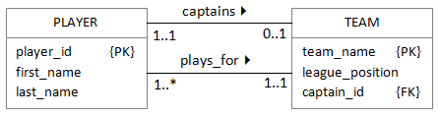
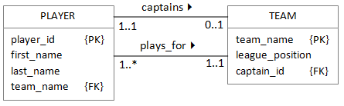
Parallel relationships

Slide 19
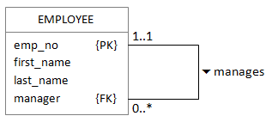
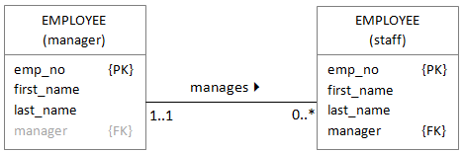
Recursive relationships
emp_no | first_name | last_name | manager
234 | Erik | Eriksson
432 | Donald | McDonald | 234
524 | Ivan | Ivanovich | 234
312 | Connor | o'Connor | 234

Slide 20
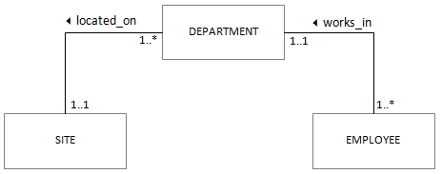
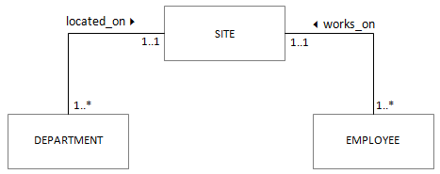
Fan traps

Slide 21
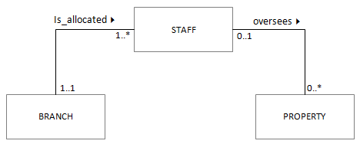
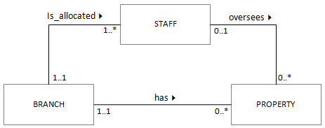
Chasm traps

Slide 22
